Slide 1
- Surbhi Sharma

Slide 2




Executive Summary
Key Insights & Recommendation
Table of Contents
Methodology & Results
Market Simulations
Market Share and Profits
Product Line Decisions
Future Strategy

Slide 3

Executive summary
Key Insights:
Age and gender will affect the choice of products.
The impacts of age is greater than gender.
Old kids concern more about price and motion.
Young kids concern more about size and style.
Female kid concern more about price, size, style.
Male kids concern more about motion.
Recommendation:
Portfolio 6 & portfolio 8 in short-term
Products 4 and 12 in long-term

Slide 4

Methodology and Process
Why conjoint is a valuable tool for this analysis?
Understand how customers evaluate products features to develop the pricing strategy.
Understand which attributes determine customers willingness to pay.
Help determine which new features should be added to products and market demand.

Slide 5
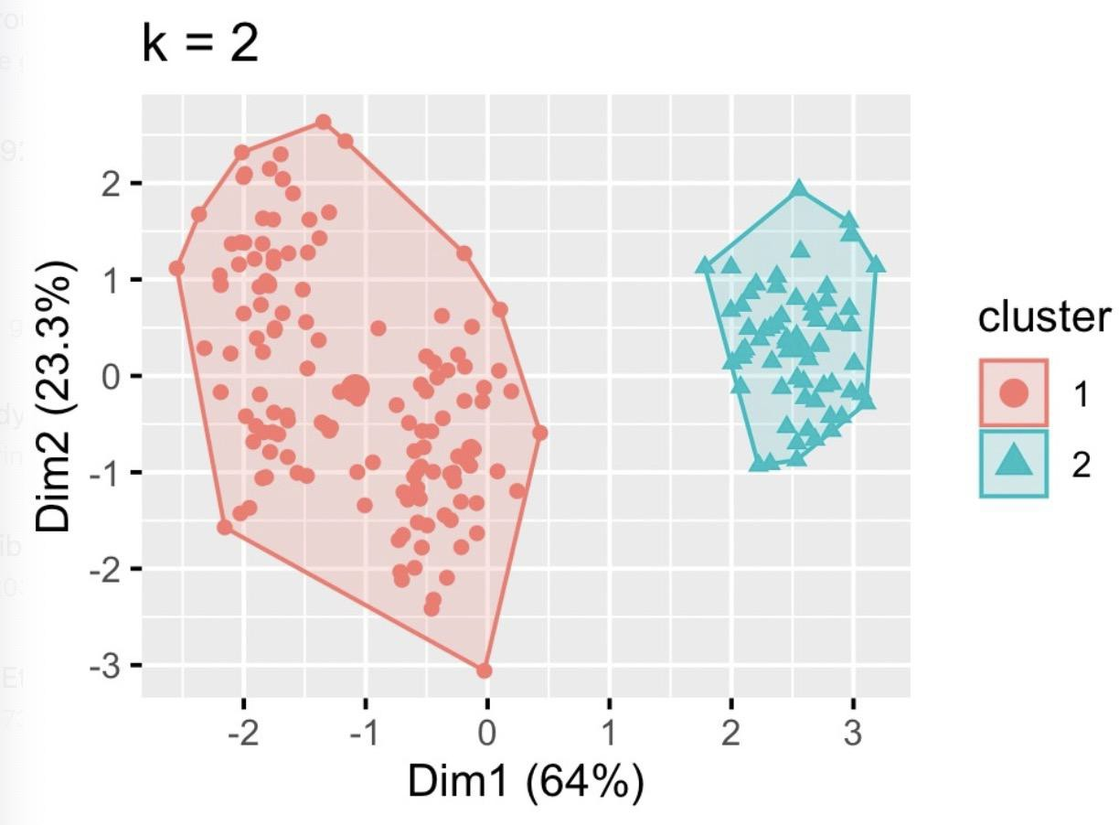
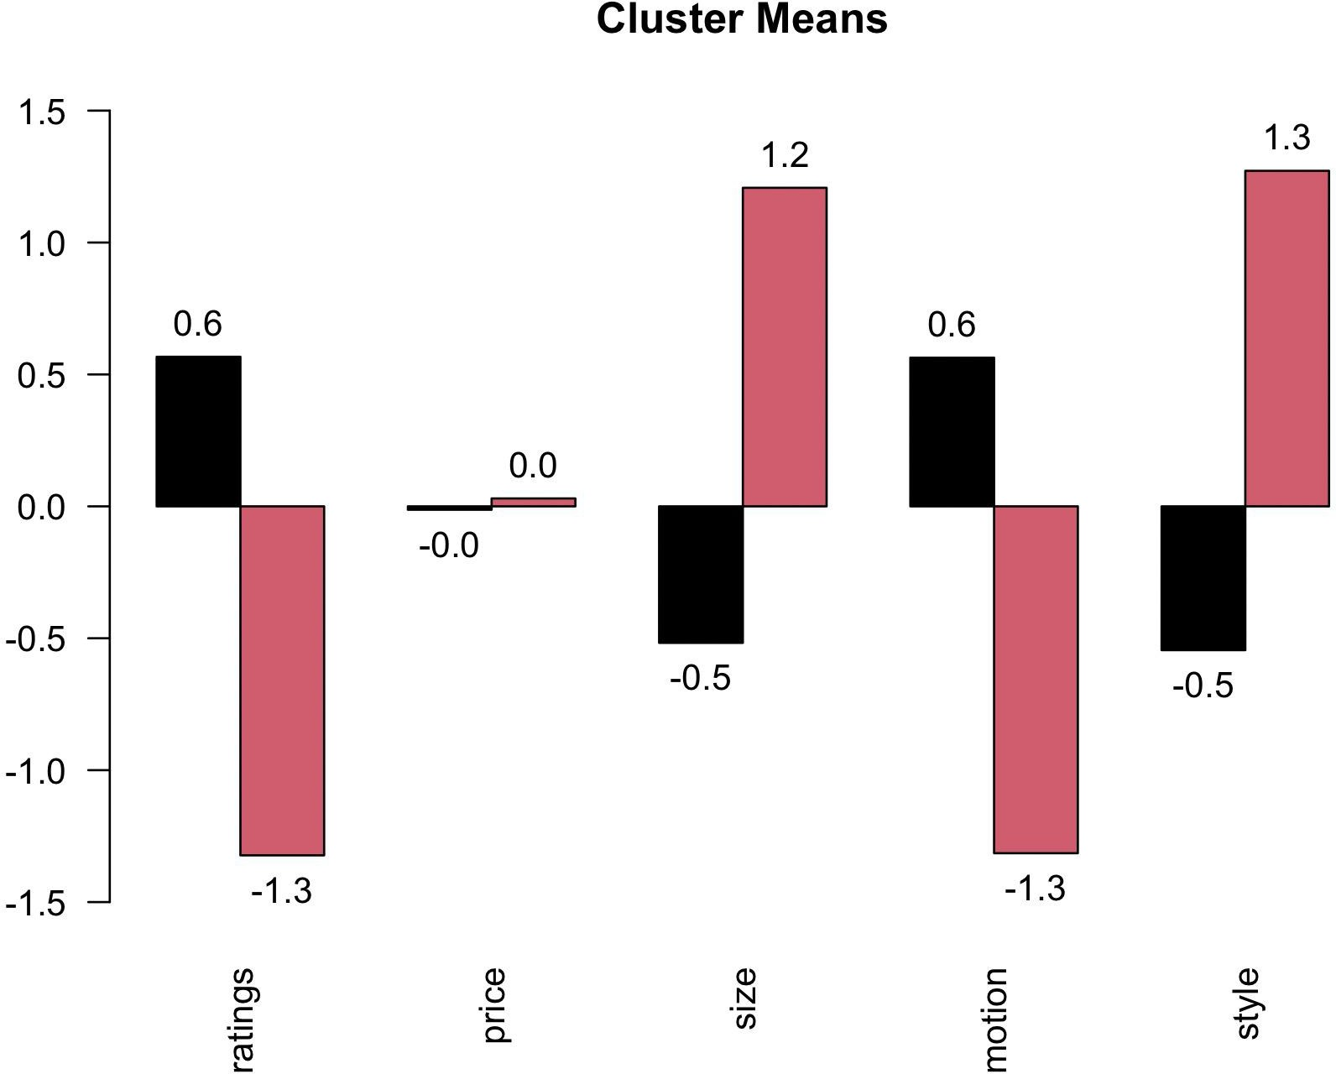
There is no overlap between cluster 1 and 2!
cluster 1 in the chosen scheme value more on motion.
profile 5 will be ideal product for segment 1.
cluster 2 in the chosen scheme value more on size and style.
profile 11, 12 will be ideal product for segment 2.
Clustering Results

Slide 6
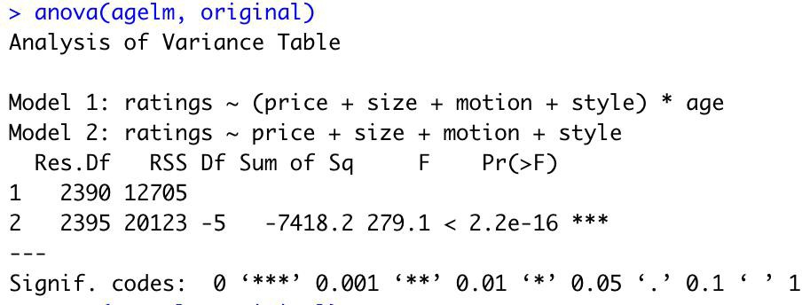
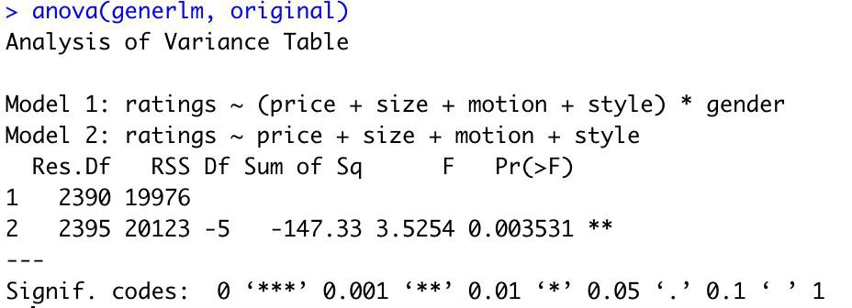
Both dummy variables age and gender will affect the choice of products
The impacts of age is greater than that of the gender
Impacts of age and gender of consumers

Slide 7
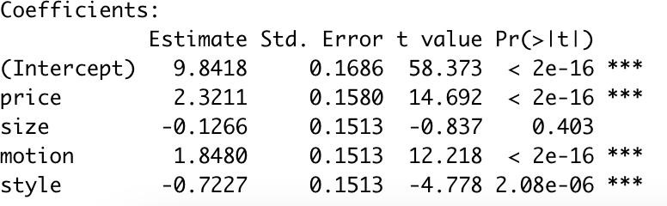
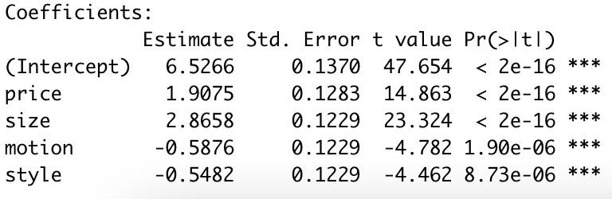
For old kids(left), price and motion have the bigger impact
For young kids(right), size and style have the bigger impact
Priori segmentation

Slide 8
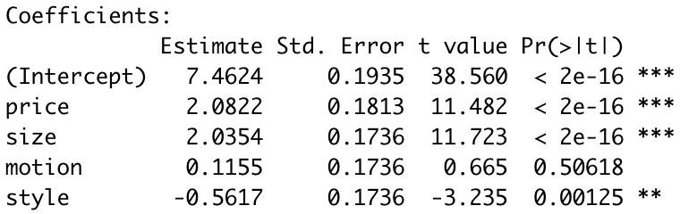
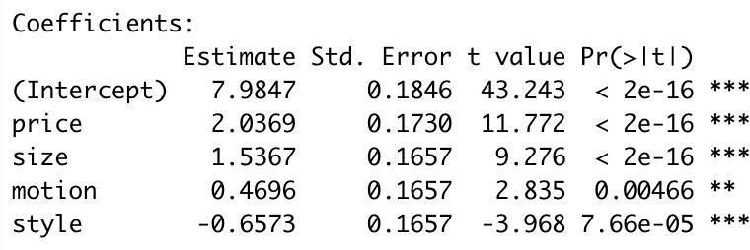
For female kids(left), price, size, style have the bigger impact
For male kids(right), the motion has the bigger impact
Priori segmentation

Slide 9


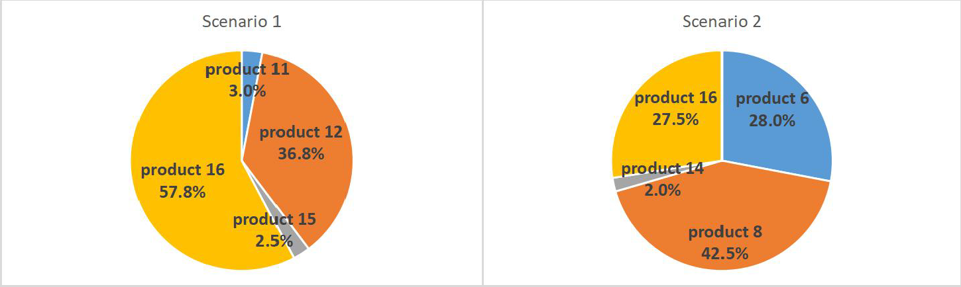
Market simulation & Market share
Analysis : Product 16 in scenario 1 has the highest market share and product 8 in scenario 2 has the highest market share.
Age(old) with size and style
Age(young) with motion and price

Slide 10
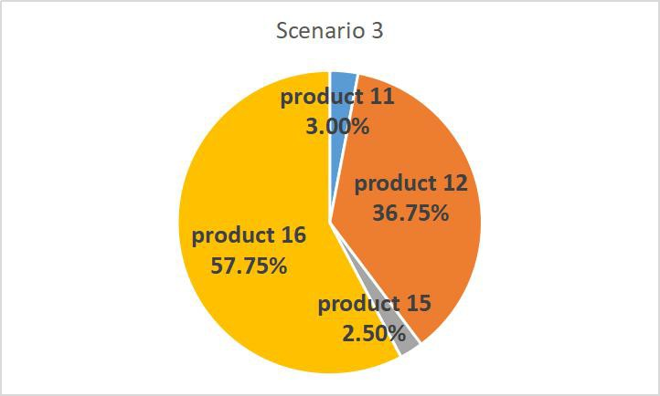
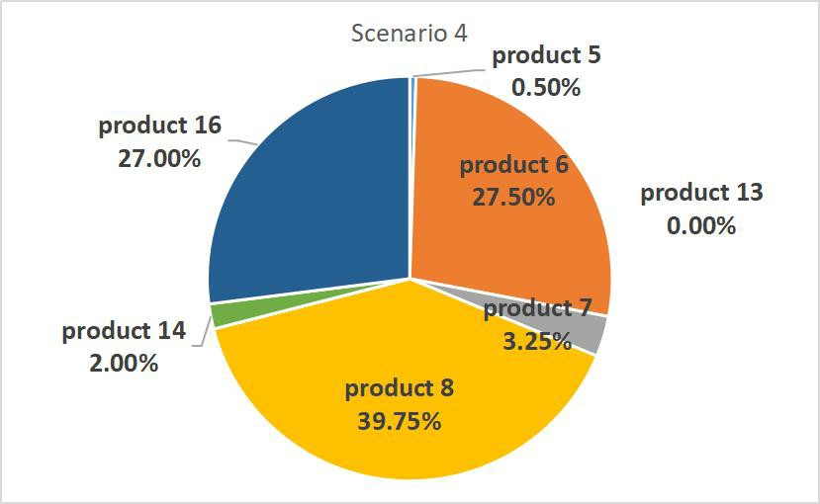
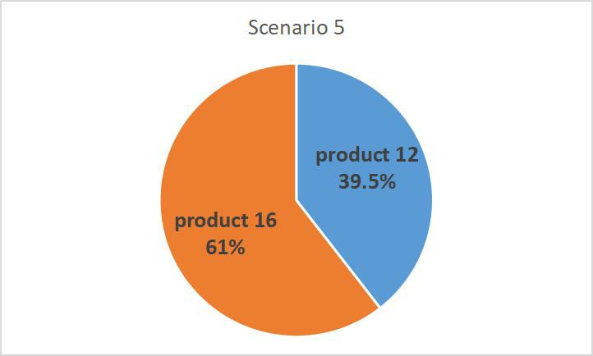
Market simulation & Market share
Gender(female) with size and style
Gender(male) with No dummy(gender and age) variabl motion
Final Analysis: Compare the market share in different scenarios, product 6,8,12,and 16 always take larger market share.

Slide 11
Scenario Profits
Scenario Profit ($) #
Scenario 1 232,410
Scenario 2 245,560
Scenario 3 232,410
Scenario 4 251,940
Gender(male) with motion
No dummy(gender and age) variable

Slide 12
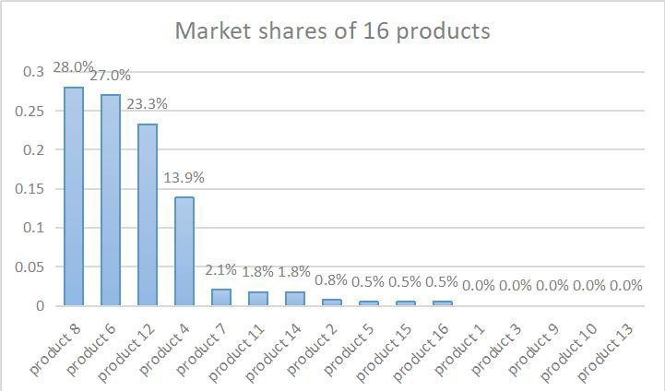
Product Line Decision
Looking at the market share of all 16 products, when the 3rd and 7th are from competitor's company, which take total
0.021 of market share, we can think about choosing product
4,6,8,12.
We also know that 6, 8, and 16 are interesting to think about, therefore we will take 6 and 8 since they are also taking important roles in general market share.

Slide 13




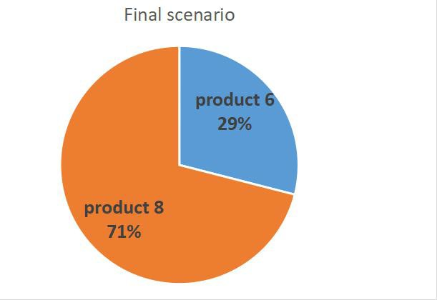

The Profit
Final Chosen Combination: P 8.
roduct 6 and
Profit: $285,240(higher than that of any previous scenarios).

Slide 14




Recommendations for future strategy :
Since products 4 and 12 have relatively smaller market share than 6 and 8, we
will choose products 6 and 8 as our first step and if our competitor has any future actions, products 4 and 12 may be
launched or we can rethink about lowering price
Future Strategy

Slide 15

THANK YOU

Slide 16
Appendix – policy survey
Name | Early riders offerings | Speed gilders offerings | Early riders profit(in $1000) | Competitor's profit(in $1000)
Status Quo | P6, P8 | P7 | $285.24 | $13.462

Slide 17
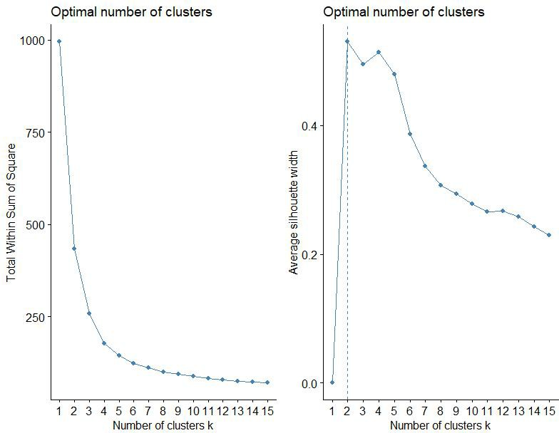
Appendix - ClustTest
clustTest <- function(toClust,print=TRUE,scale=TRUE,maxClusts=15,se ed=12345,nstart=20,iter.max=100){
if(scale){ toClust <- scale(toClust);} set.seed(seed);
wss <- (nrow(toClust)-1)*sum(apply(toClust,2,var)) for (i in 2:maxClusts) wss[i] <-
sum(kmeans(toClust,centers=i,nstart=nstart,iter.max=iter.m ax)$withinss)
gpw <- fviz_nbclust(toClust,kmeans,method="wss",iter.max=iter.m ax,nstart=nstart,k.max=maxClusts)
pm1 <- pamk(toClust,scaling=TRUE) gps <-
fviz_nbclust(toClust,kmeans,method="silhouette",iter.max=i ter.max,nstart=nstart,k.max=maxClusts)
if(print){
grid.arrange(gpw,gps, nrow = 1)
}
list(wss=wss,pm1=pm1$nc,gpw=gpw,gps=gps)
}

Slide 18
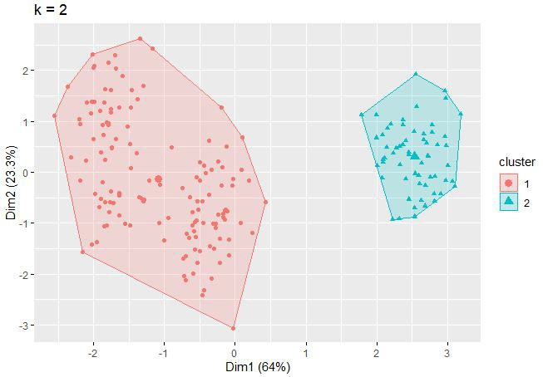
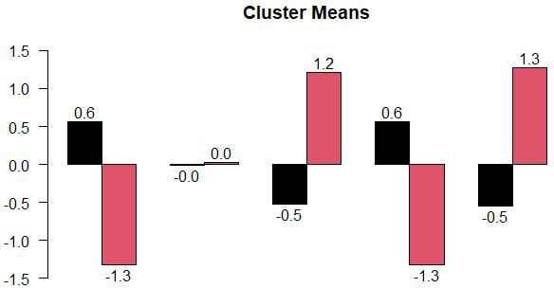
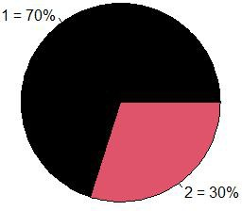
Appendix - Clustering

Slide 19
Appendix - apriori segmentation
seg<-merge(conjointData, respondentData, by="ID") original<-lm(ratings~price+size+motion+style, data=seg)
##by apriori segment
##run the regression with interactions for segment dummies agelm<-lm(ratings~(price+size+motion+style)*age, data=seg) generlm<-lm(ratings~(price+size+motion+style)*gender, data=seg) ##note if significant. can run separately for two categories
old<-lm(ratings~price+size+motion+style, data=(subset(seg,age==1))) # young kids young<-lm(ratings~price+size+motion+style, data=(subset(seg,age==0))) # young kids female<-lm(ratings~price+size+motion+style, data=(subset(seg,gender==1)))# Female male<-lm(ratings~price+size+motion+style, data=(subset(seg,gender==0)))# Male

Slide 20
Appendix - Scenario
simFCShares = function(scens,data){ inmkt = ratings[,scens] #construct the subsetted matrix of options bestvalue = apply(inmkt,1,max)
de<-matrix(nrow=200, ncol=length(scens))
for (i in 1:200)#identify which option is best = max ratings value
{
for (j in 1:length(scens)) {
de[i,j] = ifelse(bestvalue[i]==inmkt[i,j],1,0)
}
}
de.final<-de
de.final<-de/rowSums(de) #fill decisions to be 0 or 1 or 0.5 for all products
shs = colSums(de.final)/sum(de.final) #assumes that total decisions is market size
names(shs) = names(inmkt) #attach labels shs
}
cens.young=data[which(data$size=="1"&data$style=="1" &data$age=="1"),] ##age(old) on size and style scens.old=data[which(data$price=="1"&data$motion=="1 "&data$age=="0"),] ##age(young) on motion and price scens.female=data[which(data$size=="1"&data$style=="1 "&data$gender=="1"),] ##gender(female) on size and style scens.male=data[which(data$motion=="1"&data$gender=
="0"),] ##gender(male) on motion scens.nodummy=data[which(data$price=="1"&data$size=
="1"&data$style=="1"),] #no dummy
scens = list() scens[[1]]=c(11,12,15,16)
scens[[2]]=c(6,8,14,16)
scens[[3]]=c(11,12,15,16)
scens[[4]]=c(5,6,7,8,13,14,16)
scens[[5]]=c(12,16)
scens[[6]]=c(1:16)

